Slide 1
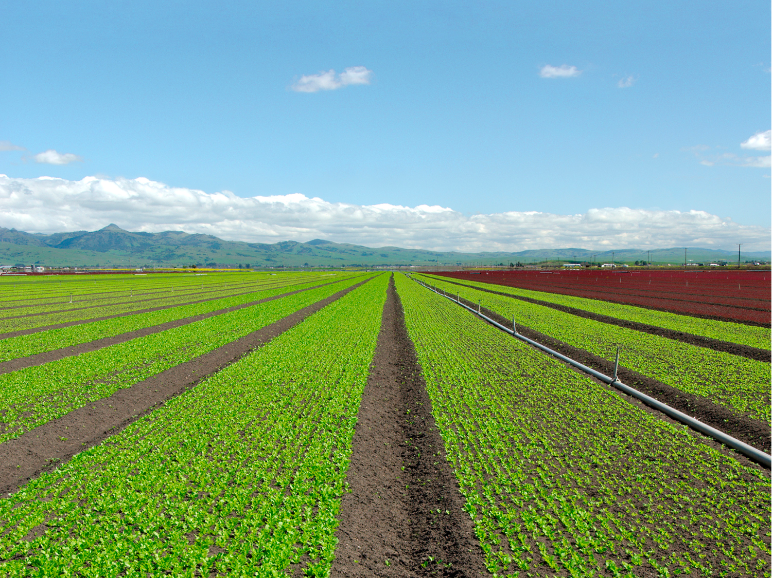

Slide 2
Welcome!
Introductions
California Council of Land Trusts
  Our Mission
Purpose of Farmland Mitigation Project
  Guidebook
  Training
Funders
  California Farmland Conservancy Program
  The Columbia Foundation

Slide 3
Guidebook Overview
Developed by the California Council of Land Trusts (CCLT) with funding from the California Department of Conservation’s California Farmland Conservancy Program and the Columbia Foundation.
Developed in recognition of renewed interest in developing and converting farmland for housing, utility scale renewable energy projects, and infrastructure development.

Slide 4
Guidebook Overview Cont.
Developed to provide resources to local government and stakeholders interested in establishing or bolstering viable, defensible farmland mitigation programs. Guidebook includes:
  Farmland mitigation easement primer
  Implementation policies and procedures for farmland mitigation
  Model conservation easement for farmland mitigation
  Memorandums of understanding
  Oversight and management of farmland mitigation endowments
  Guidelines for establishing farmland mitigation banks

Slide 5
Agenda
10:30 - 10:45 - Welcome and Introduction
10:45 - 11:15 - Farmland Mitigation Primer
11:15 - 1:00 Farmland Mitigation Implementation Policies and Procedures
Noon - 12:30 - LUNCH
1:00 - 1:30 - Guide for Effective Farmland Mitigation Easements
1:30 - 1:45 - Memorandums of Understanding
1:45 - 2:00 - Oversight and Management of Farmland Mitigation Endowments
2:00 - 2:15 - Guidelines for Establishing Farmland Mitigation Banks
2:15 - 2:30 - Final Q&A and Wrap Up

Slide 6
Farmland Mitigation Primer
Legal Framework
  CEQA/NEPA
  Policy
  Legal Cases

Slide 7

Recent Legal Cases
Building Industry Association of Central California v. County of Stanislaus et al. (2010) 190 Cal.App.4th 582 Big Deal - The court held that voluntary requirement of Civil Code section 815.3 (b) did not invalidate the FMP because the applicant and/or developer was not required to grant an easement. The easement arrangement could be made through a third party, and in any case, a developer has a choice of whether or not to develop in the first place. | Masonite Corporation v. County of Mendocino (2013) 218 Cal.App.4th 230 Big Deal - The Court concluded that “ACEs may appropriately mitigate for the direct loss of farmland when a project converts agricultural land to a nonagri­cultural use, even though an ACE does not replace the onsite resources. Our conclusion is reinforced by the CEQA Guidelines, case law on offsite mitigation for loss of biological resources, case law on ACEs, prevailing practice, and the public policy of this state. The off-site ACEs compensate for both direct and cumulative impacts on farmland, preventing the total consumption of land resources.”

Slide 8
Farmland Mitigation Primer cont.
Tools
  Fee Title
  Conservation Easements
  In Lieu Fees
  Farmland Mitigation Banks

Slide 9
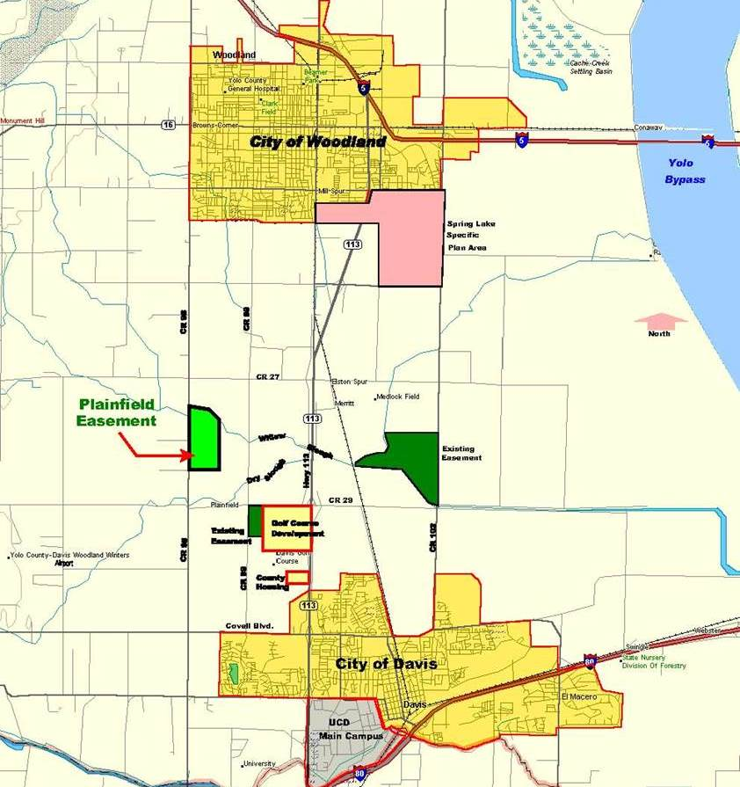

Slide 11
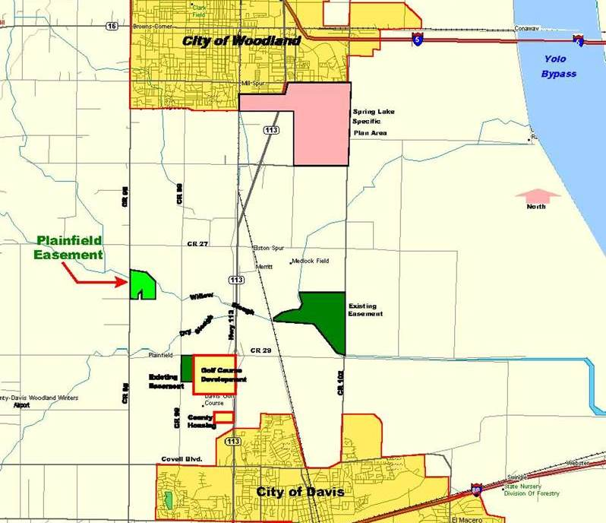

Slide 12
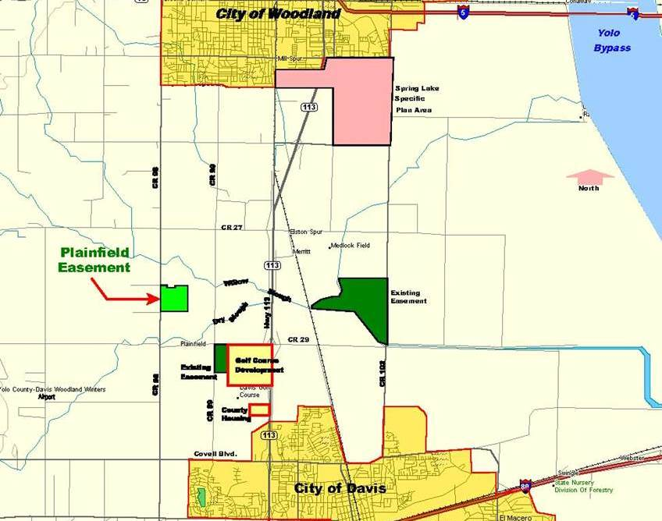

Slide 14
Farmland Mitigation Implementation Policies and Procedures
Policies and Ordinances
  What triggers mitigation?
  How and how much?
  When?
  Where?
  Who?
  Funding?
Butte County Experience
CCLT Model Ag Mitigation Ordinance
  Best Practices
Tips for Crafting Effective Farmland Mitigation Measures

Slide 15
Tips for Crafting Effective Farmland Mitigation Measures
Identify the reason for mitigation and specify both the mitigation ratio and required number of acres to be preserved.
Use enforceable language.
Specify caliber of farmland to be preserved (e.g. Prime, Farmland of Statewide Importance, Unique Farmland) and, if multiple types of farmland is to be mitigated, the required mitigation acreage for each type of farmland. Do not use vague language such a “similar to” when defining required quality of mitigation land. Consider use of Land Evaluation Site Assessment to quantify comparability of proposed mitigation site with development site. http://www.conservation.ca.gov/dlrp/Pages/qh_lesa.aspx
Specify that both farmland and related resources such as water necessary for agriculture be protected.
Specify method(s) for providing mitigation (e.g. conservation easement, mitigation bank credits, in lieu fees, fee title).
Specify geographic area where mitigation is to be located. Consider use of performance criteria instead of distinct boundaries to avoid escalating market value of mitigation lands.
Identify roles and responsibilities of county/city/agency, project proponent and mitigation holder for implementing the mitigation.

Slide 16
Farmland Mitigation Measure Tips Cont.
Require that the project proponent fully fund all costs incurred by the county/city/agency and mitigation holder inclusive of funds for the establishment of an endowment to provide for monitoring, enforcement, and all other services necessary to ensure that conservation purpose of the mitigation lands, conservation easement, or other mitigation tool are maintained in perpetuity.
Require mitigation to occur before or concurrent with project’s earliest entitlement (e.g. general plan amendment, rezone, tentative map, issuance of conditional use permit). Mitigation should occur early in the development while the intentions and expectations of the city/county/agency, project proponent, and mitigation holder are fresh in everyone’s minds and clearly understood.
Require early review by county/city/agency and mitigation holder to determine acceptability of proposed mitigation site and/or method.
If “stacking” of multiple mitigation objectives (e.g. farmland and biological resources) is proposed, ensure that objectives are compatible and that the mitigation lands/conservation easement area will remain economically viable as farmland.
Review all mitigation measures for each project to ensure they are consistent and compatible.

Slide 17
Guide for Effective Farmland Mitigation Easements
Assuring Perpetuity
  Elements of a Conservation Easement
    Recitals
    Conservation Purpose
    Permitted & Prohibited Uses
    Procedures
      Stewardship
      Enforcement

Slide 18
Framing for Conservation
The Property possesses prime agricultural soils, cultivated farmland, open space character, and ________ (Conservation Values) of great importance to Grantee and the people of the State of California.
The purpose of this Conservation Easement is to ensure that the Property will retain its agricultural productive capacity and open space character and to prevent any use of the Property that will impair or interfere with the Conservation Values of the Property (the “Purpose”). Grantor intends that this Conservation Easement will confine the use of the Property to agricultural production and open space uses.

Slide 19
Protection Hierarchy
Mitigation Requirement
Recitals
Conservation Purpose
Uses
Permitted
Prohibited
Perpetuity
Monitoring & Stewardship
Enforcement

Slide 20
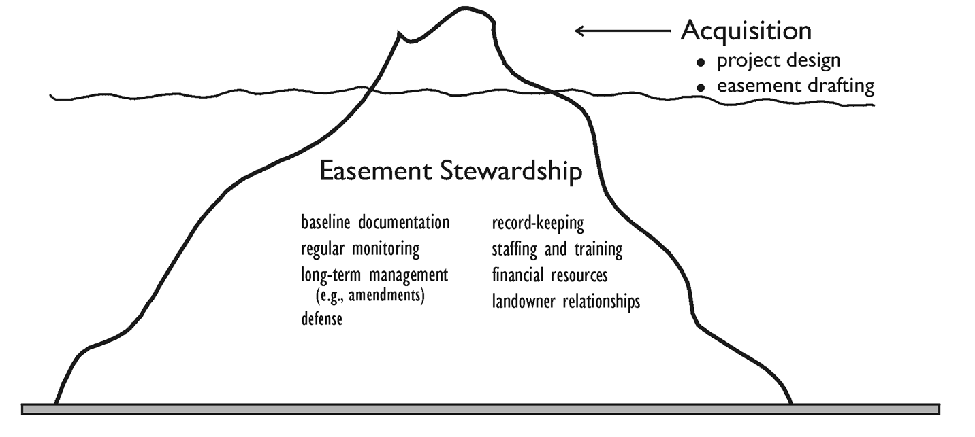
Stewardship Iceberg

Slide 21
Memorandums of Understanding
Decision Making
Communication
Endowment Holding
Monitoring
Enforcement

Slide 22
Management of Farmland Mitigation Endowments
What is an Endowment?
  Purpose
How much?
Holding and Managing
  Who
  Rules
    Uniform Prudent Management of Institutional Funds Act
    California Government Code Section 65965 - 65968

Slide 23
Uniform Prudent Management of Institutional Funds Act (UPMIFA)
Direction and protections provided by the act include:
Endowment must be managed as a “permanently restricted fund” consistent with the originating purposes of the fund.
Investment income earned on the endowment must be treated as “temporarily restricted funds” with the same restricted purpose as the endowment to ensure their application to meeting the purposes for which the fund was established.
Each person responsible for managing and investing the fund has duties of loyalty and good faith and must exercise these as an ordinarily prudent person (i.e., “prudent man test”) would.
Allows two or more funds to be pooled for investment and management purposes, but accounting must be kept separate.
Rule to consider a whole host of factors in managing and investing funds, including but not limited to, economic conditions, effects of inflation/deflation, expected tax consequences, role each investment of action plays within overall investment portfolio of the fund, and expected total return from income and appreciation of investment.
Must consider needs of the fund to make distributions and preserving capital. Further, the endowment holder may only appropriate for expenditure or accumulate so much of an endowment fund as determined prudent for uses, benefits, purposes and duration for which fund is established. This is the intergenerational equity test.
Requirement to diversify the investments of the fund unless exceptional circumstances exist.
Creates rebuttable presumption of imprudence if more than 7% of fund is expended in a given year —based on fair market value of fund —unless explicit provision has been made for such an expenditure by the formative instrument or law. Does not create a presumption of prudence for expenditures less than 7%.
Only the court and Attorney General holds authority to modify restrictions or to change the purpose of the endowment.
UPMIFA applies to all endowments that were created on or after January 1, 2009. For endowments that existed before January 1, 2009, the law governs decisions and actions taken on or after January 1, 2009.

Slide 24
California Gov. Code 65965 - 65968
The endowment shall be held, managed, invested and disbursed solely for, and permanently restricted to, the long-term stewardship of the specific property for which the funds were set aside.
The endowment shall be calculated to include a principal amount that, when managed and invested, is reasonably anticipated to cover the annual stewardship costs of the property in perpetuity.
The endowment hall be held, managed, invested, disbursed and governed as described in subdivision (a) of Section 65965 consistent with the Uniform Prudent Management of Institutional Funds Act (Part 7 (commencing with Section 18501) of Division 9 of the Probate Code).
The nonprofit corporation that holds the endowment must use generally accepted accounting practices that are promulgated by the Financial Accounting Standards Board or any successor entity. There are parallel requirements for instances in which a public agency holds the endowment.
An annual fiscal report must be submitted to the agency that required the mitigation project to be created. The fiscal report is prepared by the endowment holder unless a mitigation agreement provides for another entity to prepare the report. The following eight elements for each individual endowment held by the endowment holder must be included in the fiscal report:
• The balance of each individual endowment at the beginning of the reporting period.
• The amount of contributions to the endowment during the reporting period including, but not limited to, gifts, grants and contributions.
• The net amounts of investment earnings, gains and losses during the reporting period, including both realized and unrealized amounts.
• The amounts distributed during the reporting period that accomplish the purpose for which the endowment was established.
• The administrative expenses charged to the endowment from internal or third-party sources during the reporting period.
• The balance of the endowment or other fund at the end of the reporting period.
• The specific asset allocation percentages including, but not limited to, cash, fixed income, equities and alternative investments.
• The most recent financial statements for the organization audited by an independent auditor who is, at a minimum, a certified public accountant.
If multiple state and/or local agencies required the mitigation, including the California Department of Fish and Wildlife (DFW), the report only needs to be submitted to the DFW.

Slide 25
Guidelines for Farmland Mitigation Banks
Location
Service Area
Stacking
Credit Accounting

Slide 27
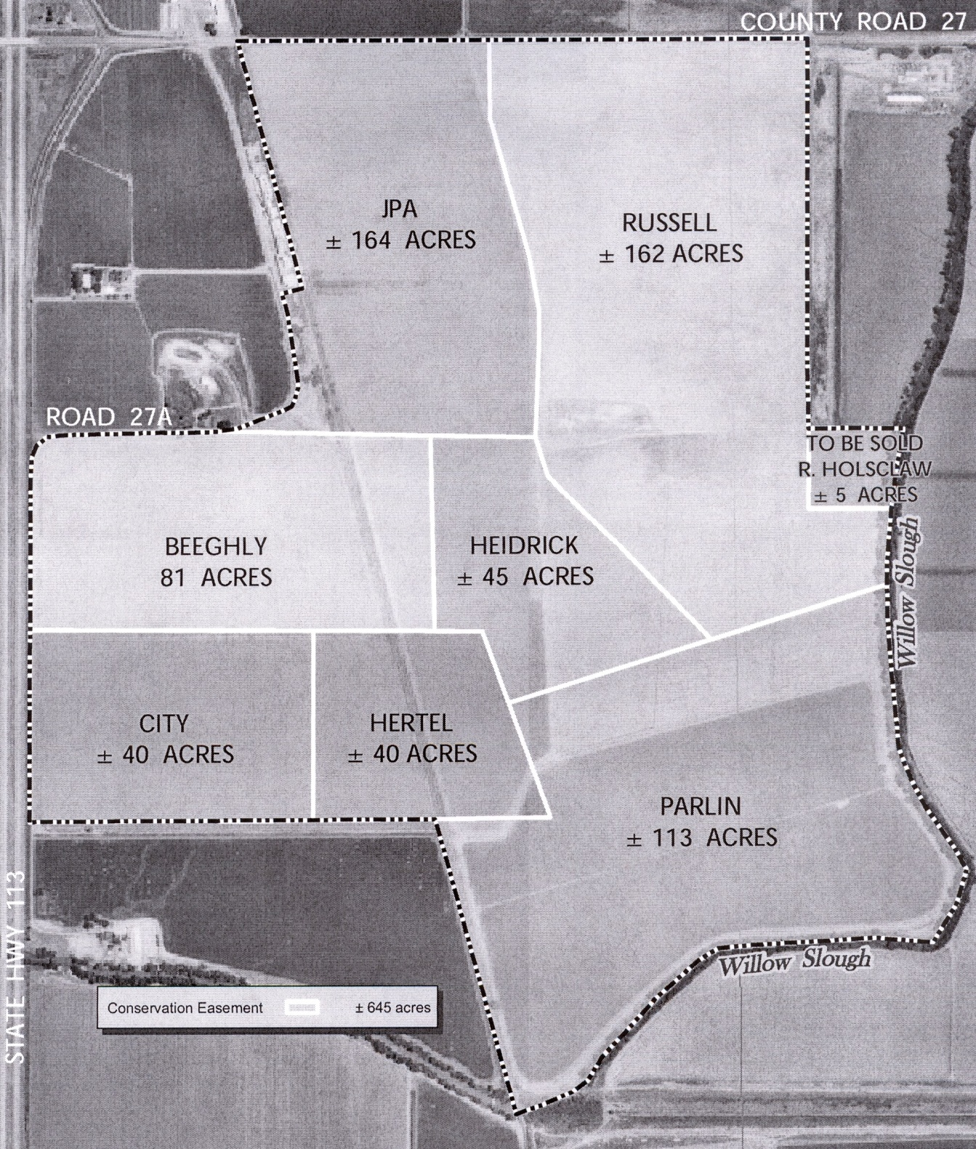

Slide 28
Resources
California Department of Conservation’s Land Resource Protection Division
  Williamson Act
  http://www.conservation.ca.gov/dlrp/lca/Pages/Index.aspx
  California Farmland Mapping and Monitoring Program
  http://www.conservation.ca.gov/dlrp/fmmp/Pages/Index.aspx
  Land Evaluation Site Assessment (LESA)
  http://www.conservation.ca.gov/dlrp/Pages/qh_lesa.aspx
  California Farmland Conservancy Program
  http://www.conservation.ca.gov/dlrp/cfcp/Pages/Index.aspx
  Model Agricultural Conservation Easement
  http://www.conservation.ca.gov/dlrp/cfcp/overview/Pages/cfcp_model_easement.aspx
California Office Attorney General’s Office of Charitable Trusts Division
http://oag.ca.gov/charities
  Use listing of registered charities to confirm status of potential conservation easement holder per requirements of CA Civil Code 815.3(a) http://rct.doj.ca.gov/MyLicenseVerification/Search.aspx?facility=Y
  Amendments, terminations, and extinguishments of conservation easements require review and approval by the Attorney General.

Slide 29
Resources Cont.
Natural Resources Conservation Service (NRCS) – California
http://www.nrcs.usda.gov/wps/portal/nrcs/site/ca/home/
NRCS Web Soil Survey and Mapping
http://websoilsurvey.sc.egov.usda.gov/App/HomePage.htm
Customized, site specific soil reports can be generated and downloaded from this site.
California Council of Land Trusts (CCLT)
http://www.calandtrusts.org/
An umbrella organization for California land trusts. CCLT members have been vigorously reviewed for professional practices.
Can provide technical assistance in:
  Identifying qualified mitigation partners
  Best practices for land protection and mitigation
  Best practices for conservation strategies
  Updated information on current or recent legislation, court cases and policies and practices for land protection and mitigation.
Land Trust Alliance (LTA)
http://www.landtrustalliance.org/
A national advocacy and education organization for land trusts and land conservation. Maintains the national land trust accreditation program http://www.landtrustaccreditation.org/

Slide 30
Wrap Up
Questions
Evaluations

