Slide 1

Keeping the
Best of California
A Land Conservation Retrospective

Slide 2
To farther backward you can look,
the farther forward you can see.
-Winston Churchill

Slide 3
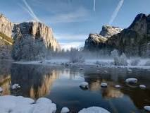
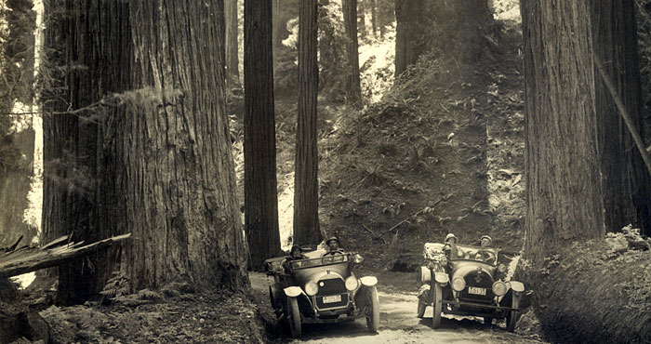
The beginnings of conservation tradition in California
1870: California Dept. of Fish & Game created
1885: Department of Forestry & Fire
Protection created
1890: Yosemite National Park established
1899: Sempervirens Club founded
1902: Big Basin Redwoods State Park established

Slide 4
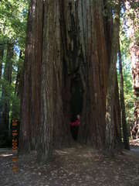
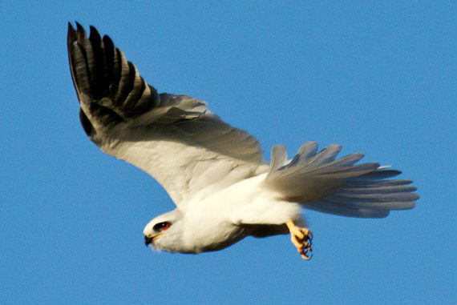
1918: Save the Redwoods League established
1926: Riverside County Regional Park/
Open Space District established
1927: California State Parks founded
Department of Conservation created
1928: First State Parks Bond Act passed

Slide 5
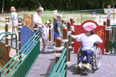
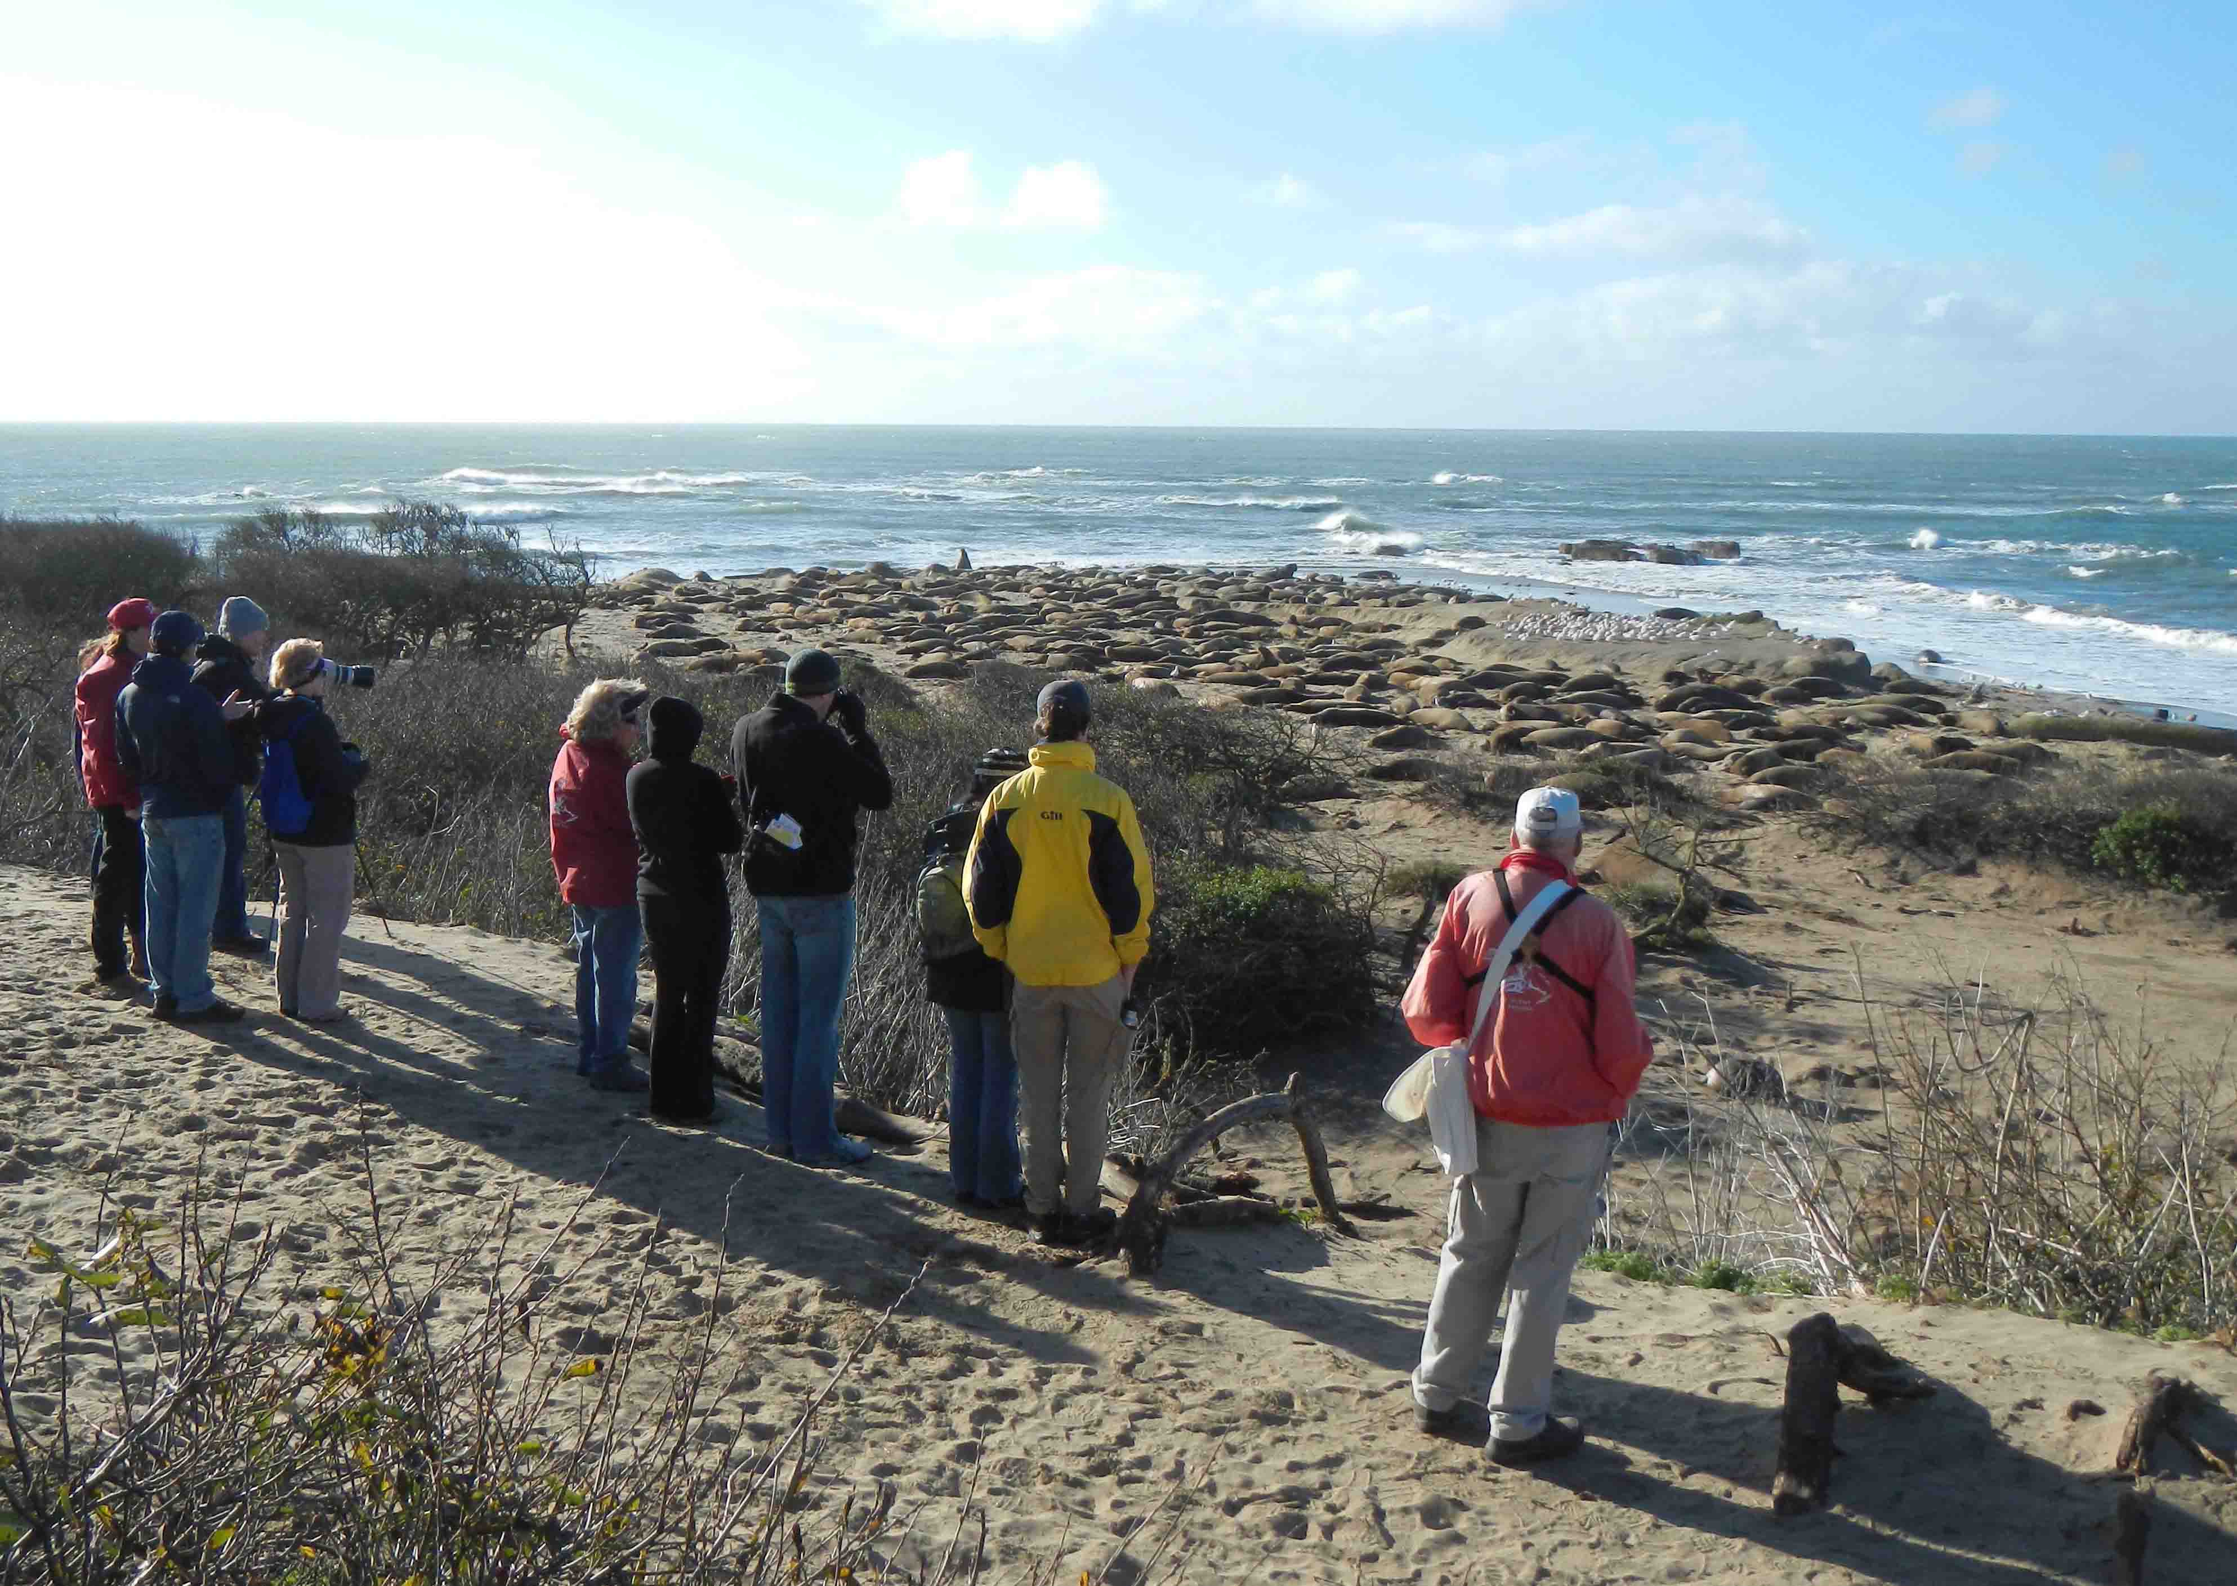
1934: East Bay Regional Parks District established
1947: Wildlife Conservation Board created
Livermore Area Recreation & park district esablished
1951: The Nature Conservancy Founded

Slide 6
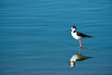

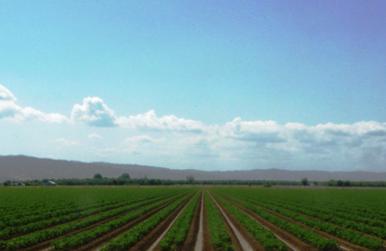
1956: Department of Water Resources created
1961: Natural Resources Agency created
1965: The Williamson Act passed

Slide 7
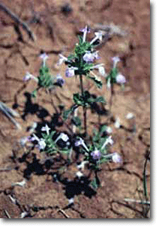
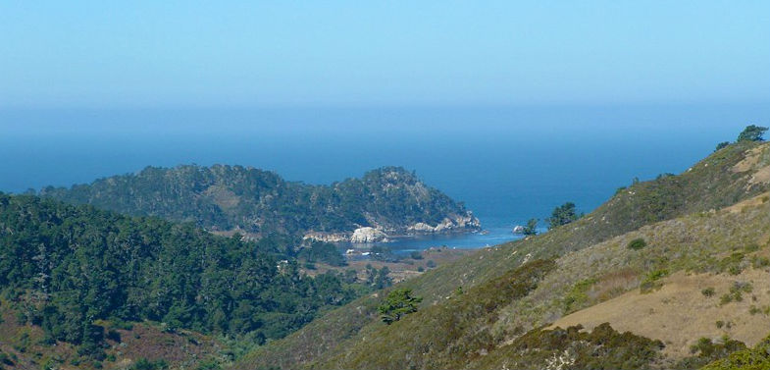
A Generation of Progress
1970: California Endangered Species Act passed
California Environmental Quality Act Review established
Proposition 20 passed
1972: Marin County Parks/Open Space Dist. established
Mid-Peninsula Reg. Open Space Dist. established
Monterey Peninsula Reg. Open Space Dist. established

Slide 8


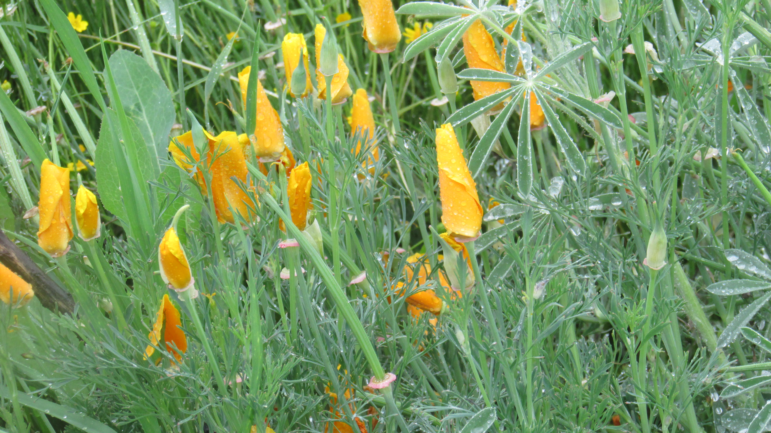
1976: The California Coastal Commission established
California Coastal Conservancy established
California Conservation Corps created
1977: Peninsula Open Space Trust created
1979: Conservation Easement Act passed, amended 1981, 2004

Slide 9
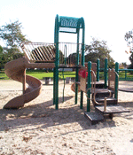
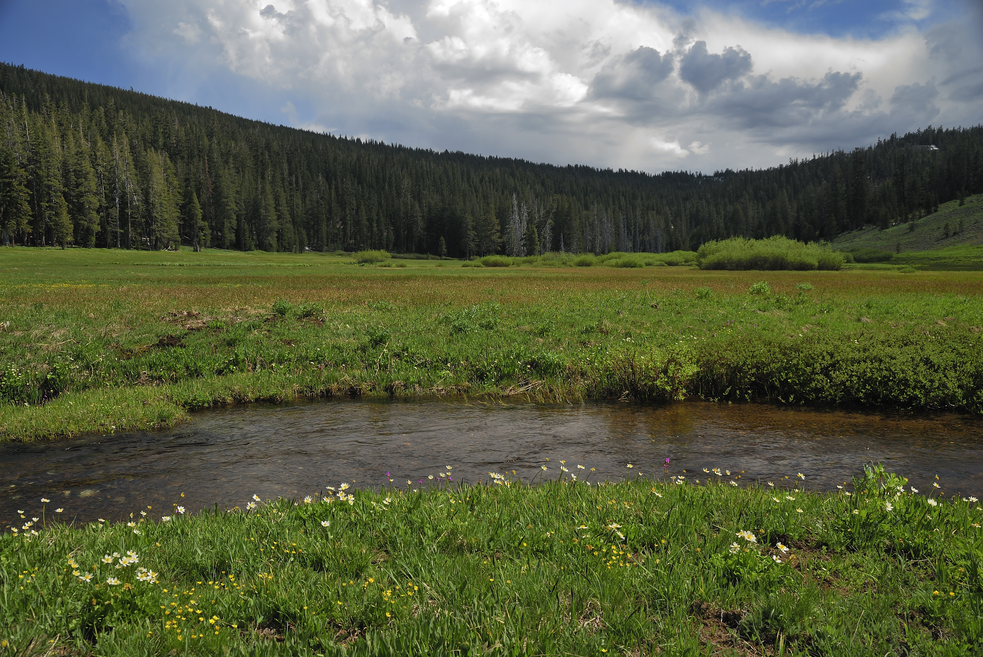
1980: Federal Charitable Income Tax Deduction enacted
Santa Monica Mountains Conservancy created
1982: Lake Tahoe Acquisitions Bond Act
1984: Tahoe Conservancy established
CA Endangered Species Act passed
1988: Proposition 70 passed
1989: Environmental Enhancement Mitigation program created

Slide 10
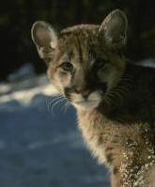
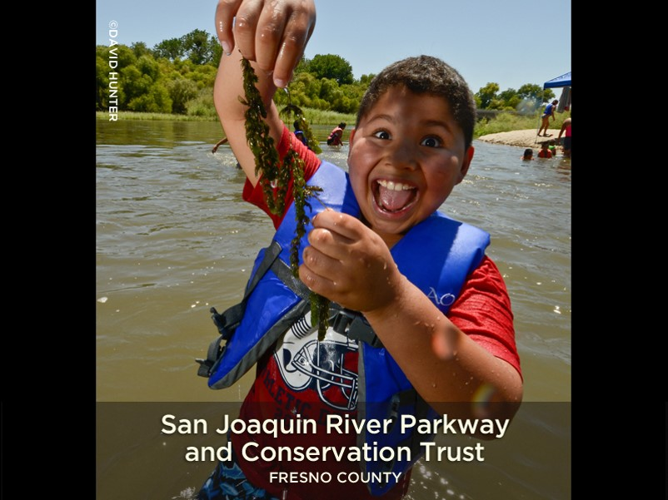
1990: California Wildlife Protection Act approved by voters
Bay Area Open Space Council established
Sonoma County Agricultural Preservation &
Open Space District created
1991: Coachella Valley Mountains Conservancy established
1992: San Joaquin River Conservancy established
1993: Santa Clara Open Space Authority established

Slide 11
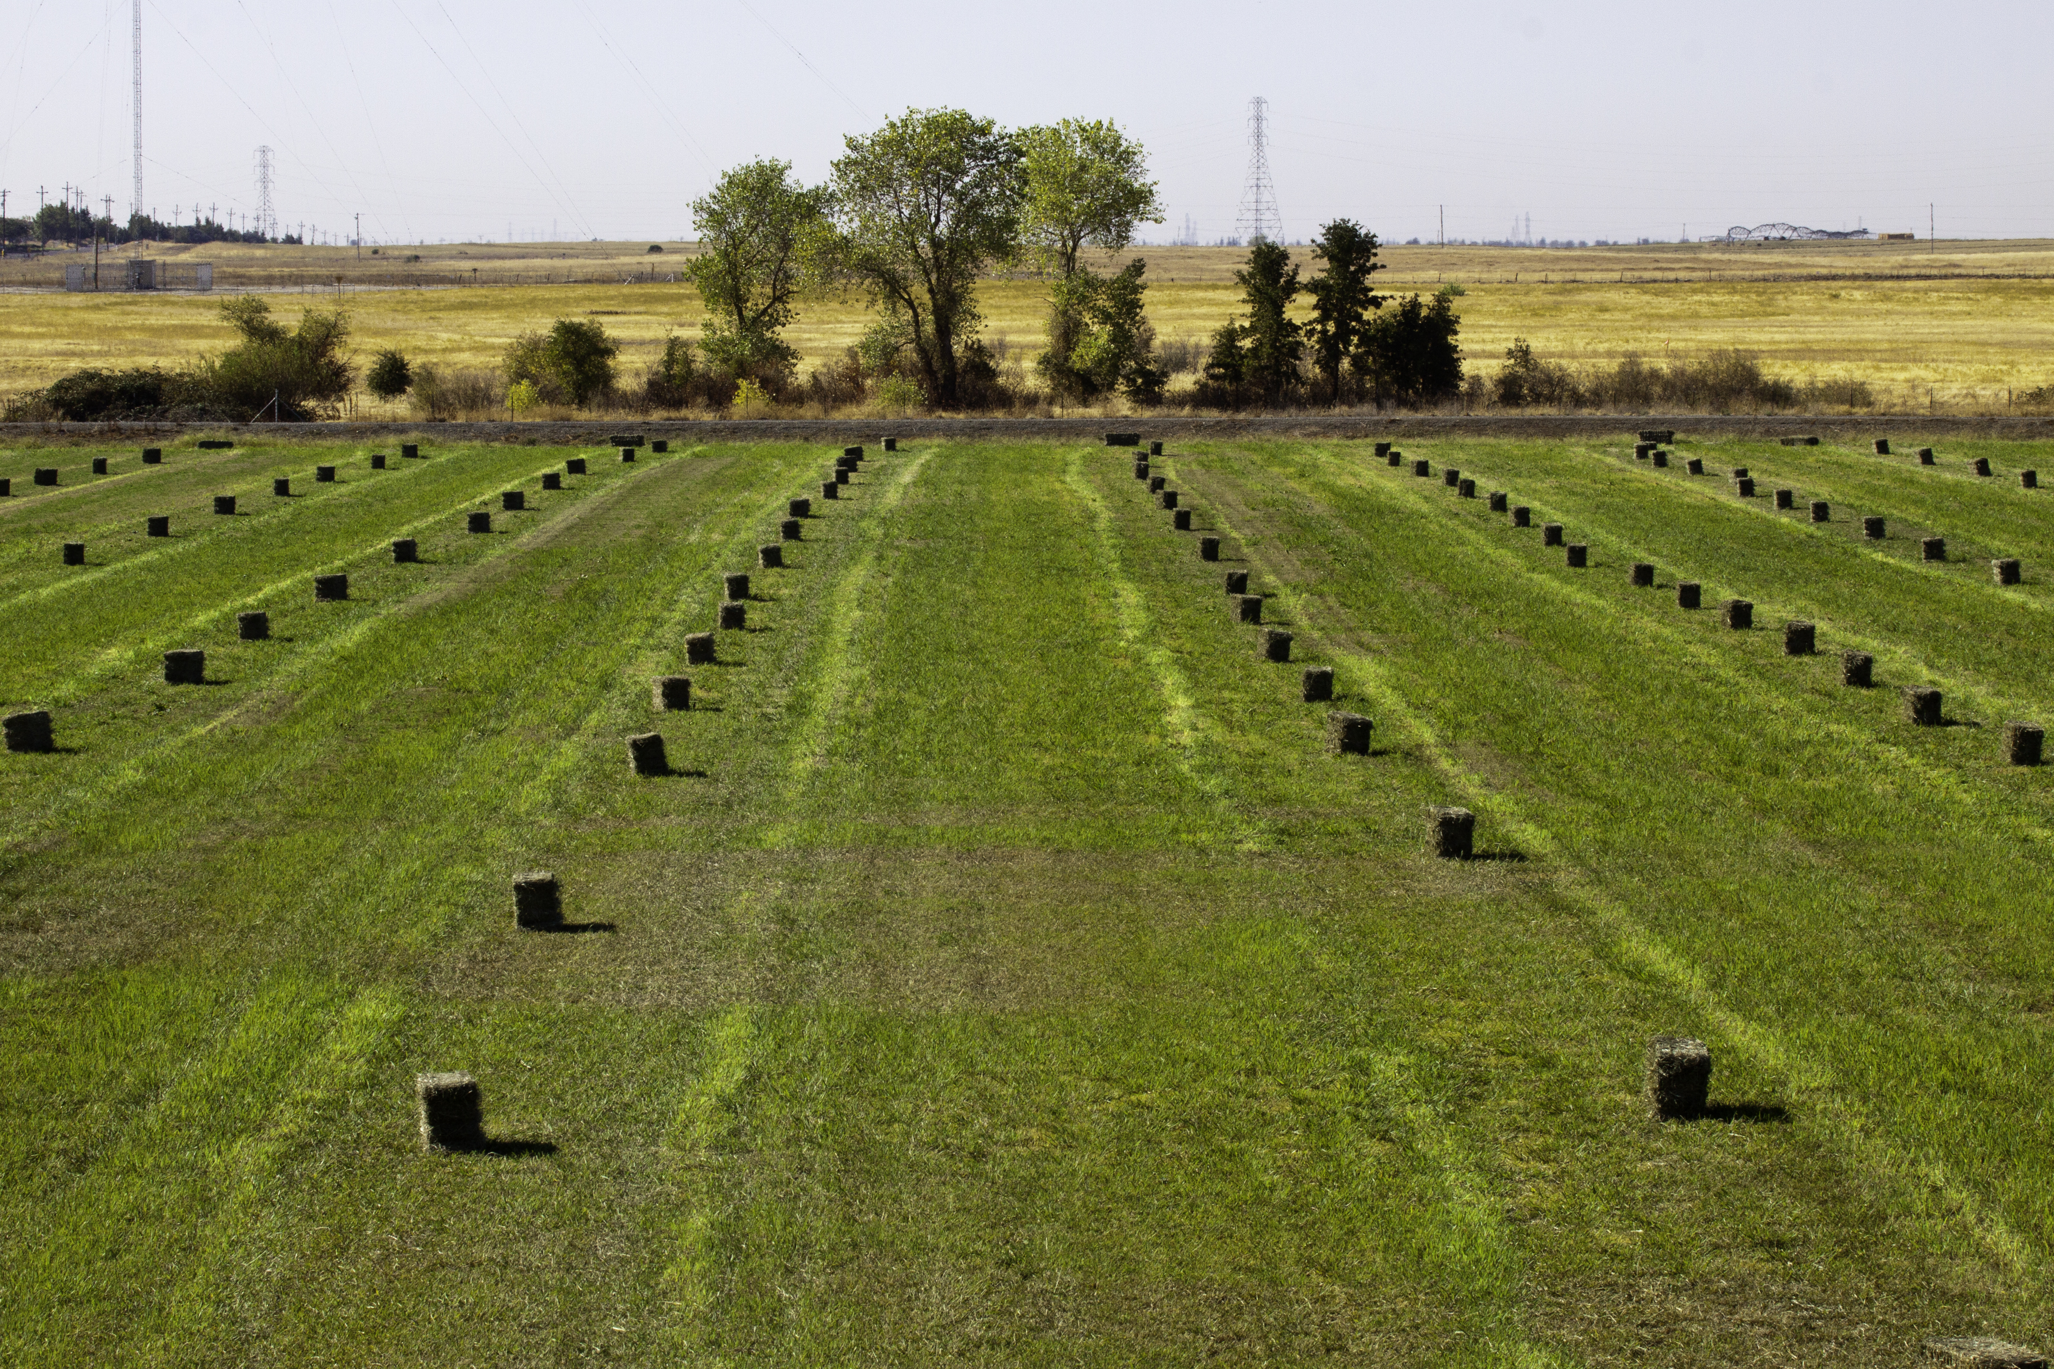

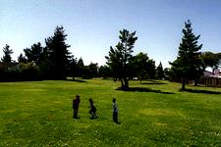
1995: CA Farmland Conservancy Program created
1998: Conserving California Landscape Initiative created
by Packard Foundation
1999: San Gabriel and Lower Los Angeles Rivers
and Mountains Conservancy established

Slide 12
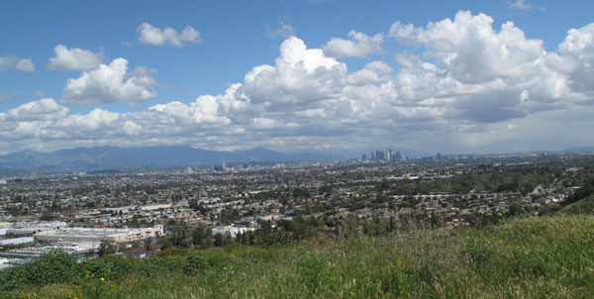
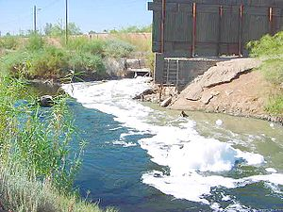
2000: Proposition 12 passed
Proposition 13 passed
Natural Heritage Preservation Tax Credit
Act of 2000 passed
Baldwin Hills Conservancy established
2002: Proposition 40 passed
Proposition 50 passed
San Diego River Conservancy established
Integrated Reg. Water Management
Program created

Slide 13
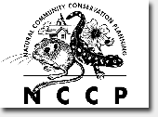
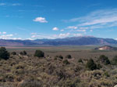
2003: Natural Community Conservation Planning Act passed
2004: Sierra Nevada Conservancy established
California Ocean Protection Council created
2006: Proposition 84 passed
Napa County Reg. Parks/Open Space
District established

Slide 14
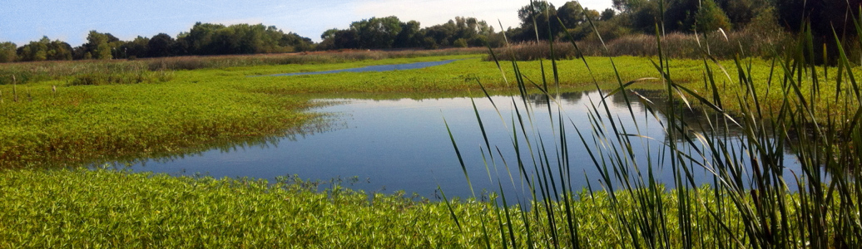
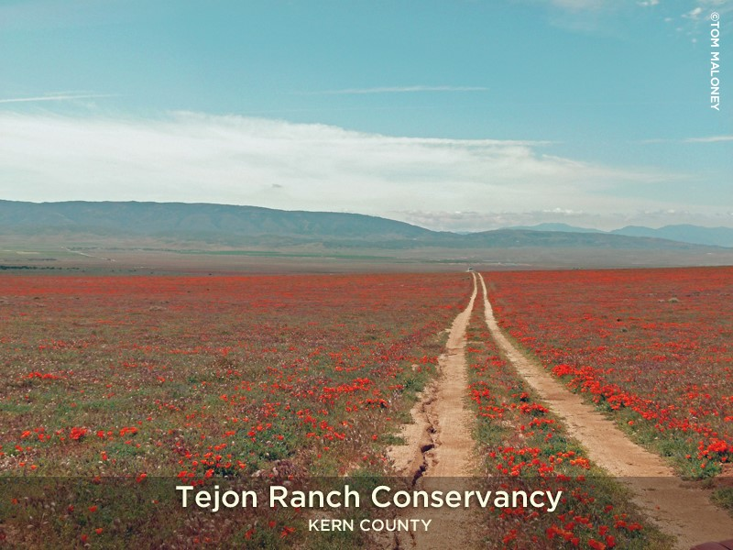
2008: Proposition 21 failed
Strategic Growth
Council created
2009: Sacramento-San Joaquin Delta Conservancy established
California state bond funding freeze issued
California State Safe Harbor Agreement Program Act established
2014: Conservation easement
acquisition at Tejon Ranch
brings total to 110,000 acres

Slide 15
State Bond Acts since 2000:
$15.5 billion for land and water
Prop 12 – 2.1 Billion
Prop 13 – 1.97 Billion
Prop 40 – 2.6 Billion
Prop 50 – 3.44 Billion
Prop 84 – 5.38 Billion
∗California’s first State Park Bond Issue was $6 Million

Slide 16
Foundation Funding
Conserving California Landscape Initiative
David & Lucile Packard Foundation
$175 million during 1998-2003
Outcomes:
342,000 acres protected in in Central Coast, Central Valley, Sierra Nevada regions – final outcome 400,000 acres
Attracted matching funds totaling roughly $1B from other foundations, government agencies and individuals

Slide 17
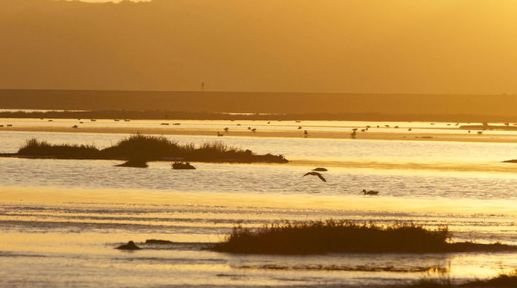
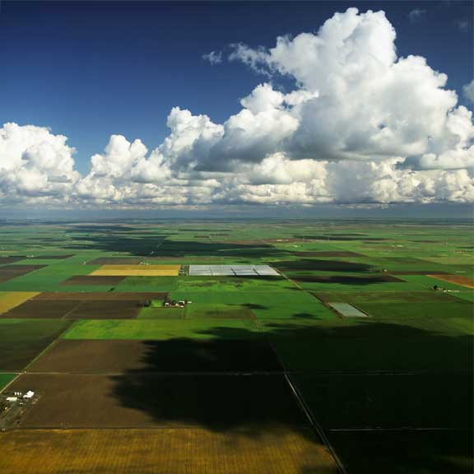
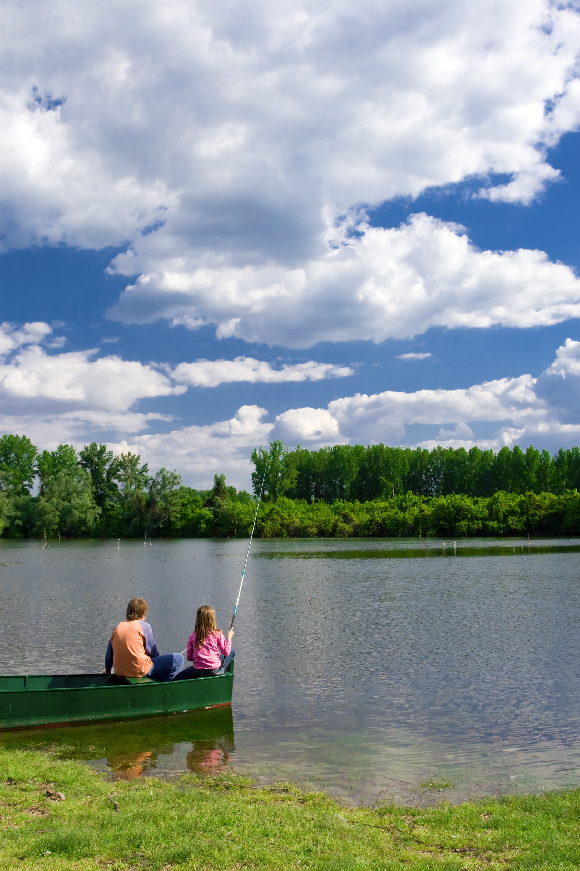
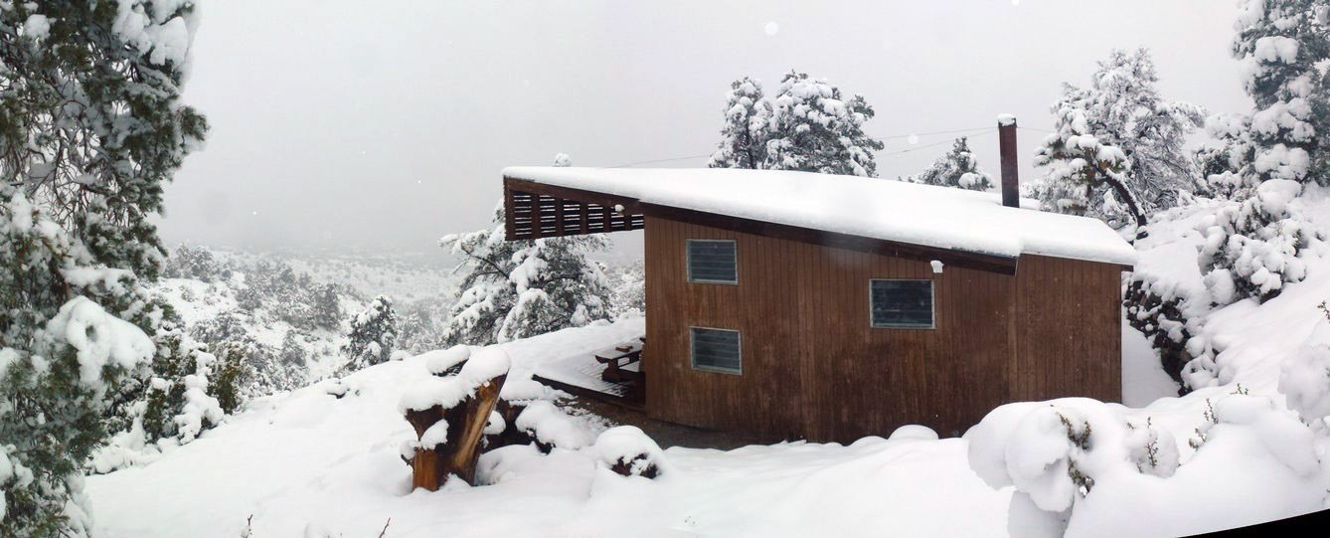
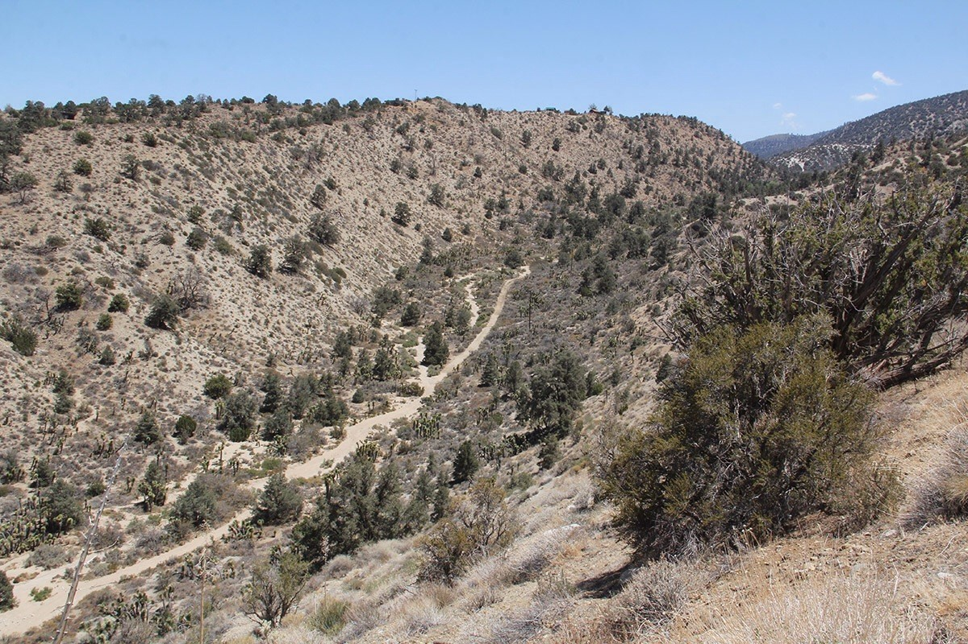
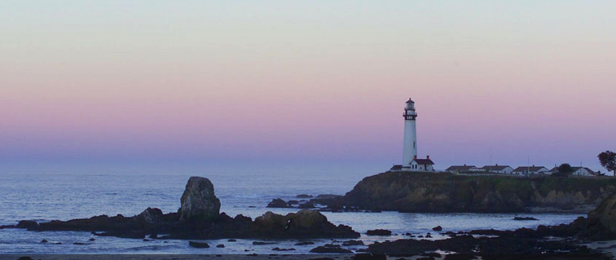
Over 1.7 million acres held by land trusts…

Slide 18
150+ land trusts
at work in local communities in every California county
Number of Land Trusts
Decades beginning 1890

Slide 19
A Land Trust Progression…
Remote Natural Parks, Habitat Areas
Cultural Resources
Working landscapes… farm, ranch, forest
Water resources
Urban parks
Acquire
Fee and ‘flip’
Acquire easements and retain
Acquire fee and retain
Take on mitigation projects

Slide 20
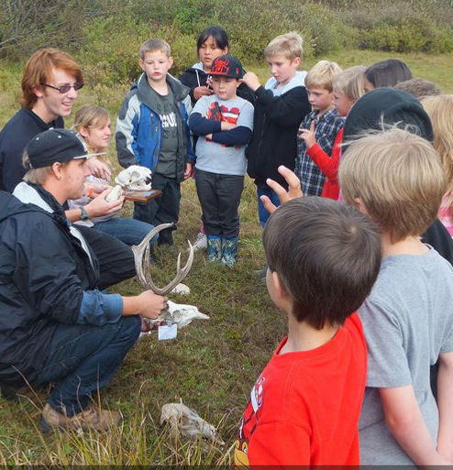
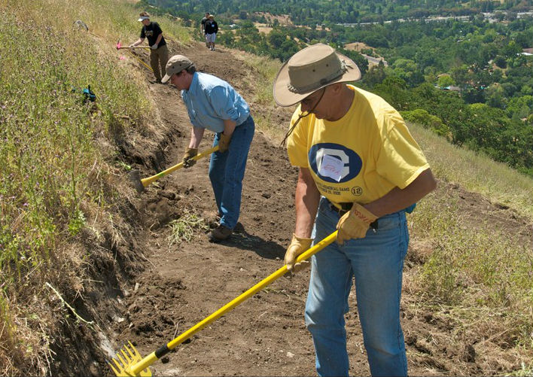
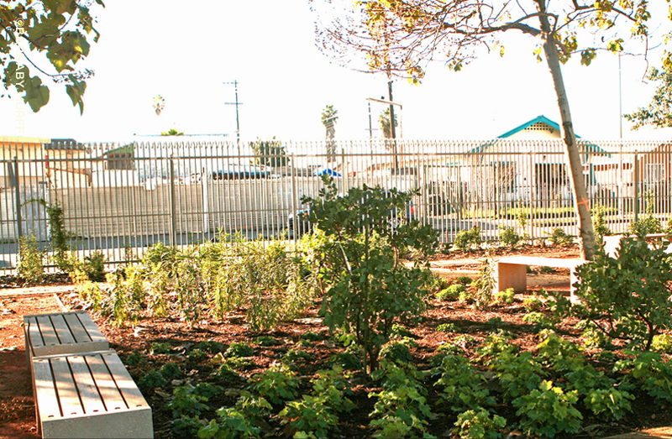
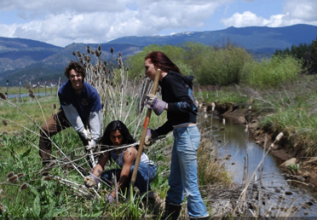
Land trusts are…
Offering
education programs
Building trails
Growing community gardens
Undertaking restoration projects

Slide 21
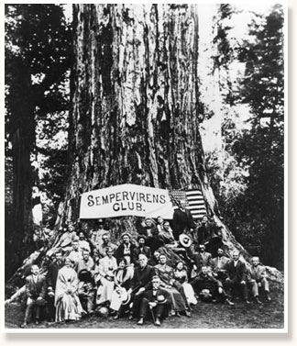
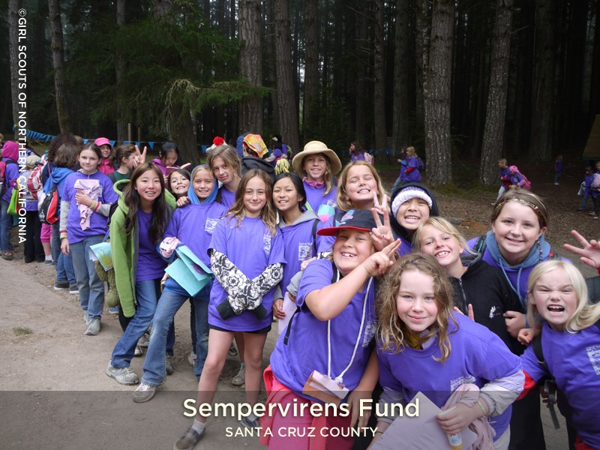
Some things never change. They just become different.
- Joshua Caleb

Slide 22
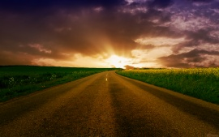
To farther backward you can look,
the farther forward you can see.
-Winston Churchill

